Slide 1
IOT BASED SOLAR TRACKER
1)Ashutosh Singh-41
2)Amogh Lonare-40
3)Harsh Singh-33

Slide 2
INTRODUCTION
Solar energy is rapidly gaining notoriety as an important means of expanding renewable energy resources.
As such, it is vital that those in engineering fields understand the technologies associated with this area.
Our project will include the design and construction of a microcontroller-based solar panel tracking system.
Solar tracking allows more energy to be produced because the solar array is able to remain aligned to the sun.
This system builds upon topics learned in this course. A working system will ultimately be demonstrated to validate the design. Problems and possible improvements will also be presented.

Slide 3
LITERATURE SURVEY:01
TOPIC:A Review on an Automatic Solar Tracking System
The purpose of designing a solar tracker is to propose the conception and development of solar tracking system, such that the solar panel throughout the sunshine hour’s remains perpendicular to sunlight beam and fit’s to the users power requirement.
The conception of light tracking system is quite simple, where light detectors detect position of the sun, based on sensors readings, and generated sun tracking error, based on error, the control unit generates the voltage used to command the drive circuit to drive a low- speed motor, that outputs the rotational speed or displacement of electric motor, (to rotate the solar panel via a speed-reduction system) until it perpendicularly faces the sun.

Slide 4
LITERATURE
TOPIC: Modeling and Designing of Solar Tracking System using Arduino
The circuit of the solar tracker system is divided into three sections. There is the input stage thatis composed of sensors and potentiometers, a program in embedded software in the Microcontroller and lastly the driving circuit that has the servo motor.
The input stage has two LDRs that are so arranged to form a voltage divider circuit. A C program loaded into the Atmega328P forms the embedded software. There is a metallic frame that houses the components. The three stages are designed independently before being joined into one system.
This approach,similar to stepwise refinement in modular programming, has been employed as it ensures anaccurate and logical approach which is straight forward and easy to understand. This also ensuresthat if there are any errors, they are independently considered and corrected.

Slide 5
Discussion:
The project “Modelling And Designing of Solar Tracking System Using Arduino” has been successfully designed and tested. It has been developed by integrating features of all the hardware components used and software also in which we have used C language.
Presence of every module has been reasoned out and placed carefully thus contributing to the best working of the unit.
Secondly, using highly advanced microcontroller and with the help of growing technology the project has been successfully implemented. It has been concluded that by implementing these systems we can make our environment clean.

Slide 6
LITERATURE
TOPIC:SOLAR TRACKING SYSTEM FOR AFRICA’S
UNDERUTILIZED SOLAR POWER
The solar power works by capturing energy from the sun and converting it into electricity for home and industrial usage .
The International Energy Agency indicated that since 2010, solar photovoltaic capacity has increased considerably as compared to previous four decades . Tsao et al. indicated that there is more energy from the sun that hits the earth in just an hour than worldwide consumption for the year 2010 [5]. This clearly shows the incredible potentials available in solar power.
The solar power system consists of solar panels, solar battery storage system and solar invertor as displayed in fig 1 which works together to produce the energy needed.

Slide 7
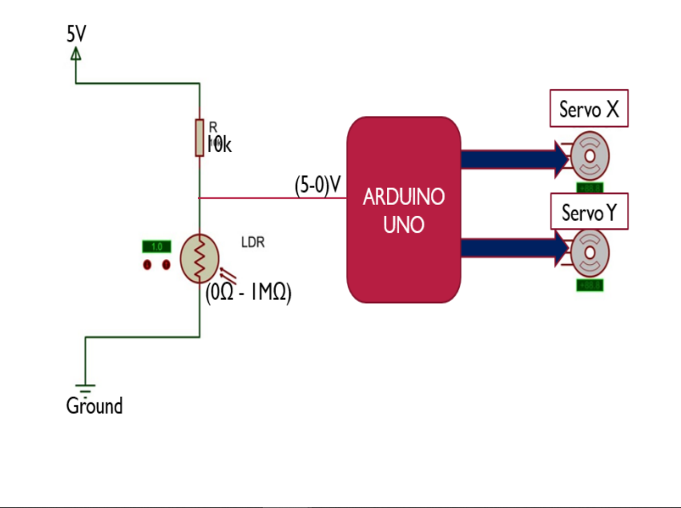
Basic circuit diagram
An overview of the required circuit for the Dual-axes solar tracker is shown here. The 5V supply is fed from an USB 5V dc voltage source through Arduino Board.
Servo X :Rotates solar panel along X direction
Servo Y :Rotates solar panel along Y direction

Slide 8
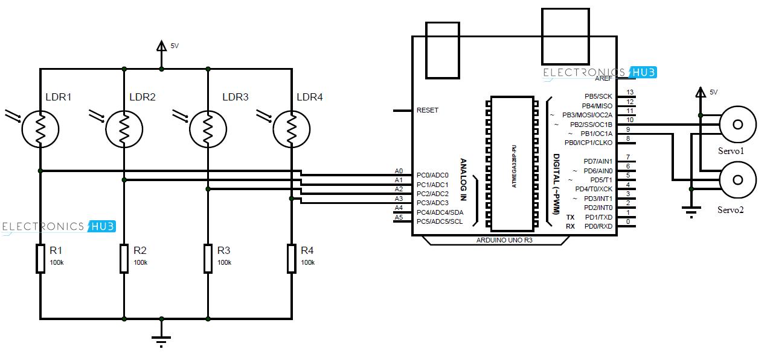
BLOCK DIAGRAM

Slide 9
Advantages
Solar energy is a clean and renewable energy source.
Once a solar panel is installed, the energy is produced at reduced costs. Whereas the reserves of oil of the world are estimated to be depleted in future, solar energy will last forever.
It is pollution free.
Solar cells are free of any noise. On the other hand, various machines used for pumping oil or for power generation are noisy.
On average, it is possible to have a high return on investment because of the free energy solar panels produce

Slide 10
Disadvantages
Solar panels can be costly to install resulting in a time lag of many years for savings on energy bills to match initial investments.
Generation of electricity from solar is dependent on the country’s exposure to sunlight. That means some countries are slightly disadvantaged.
Solar power stations do not match the power output of conventional power stations of similar size. Furthermore, they may be expensive to build.
FINALLY,
As the merits are more than the demerits, the use of solar power is considered as a clean and viable source of energy. The various limitations can be reduced through various ways.

